Slide 1
Extend Office
Office Add-ins.
Office JS APIs.
Customization of Add-ins.
Testing, debugging, and deployment options for Office Add-ins.
Actionable messages.

Slide 2
Office Add-ins

Slide 3
Overview of the Office Add-in platform
All Office Add-ins built upon the Office Add-ins platform share a common framework. Developers use familiar web technologies such as HTML, CSS, and JavaScript to build a solution that can run in Office across multiple platforms.
Add-ins allow developers to provide:
Additional functionality in Office.
Embedded rich, interactive objects.
Benefits of Office Add-ins:
Cross-platform support.
Centralized deployment and distribution.
Public availability via AppSource.
Built using standard web technology
Notes:
Explain Overview of the Office Add-in platform.

Slide 4
Overview of the Office Add-in platform
Components of an Office Add-in:
Manifest.
Web application .
Supported Office Add-in types, hosts, and platforms:
Extend functionality
Create new objects
Notes:
Explain Overview of the Office Add-in platform.

Slide 5
Overview of the Office Add-ins platform
Office Add-ins run in various Office applications on certain platforms.
The following table lists Office applications, platforms, and add-in types.
Office application | Supported platforms | Available add-in types
Excel | Windows, Mac, iPad, web browser | task pane, content, custom functions (excluding iPad)
OneNote | web browser | task pane
Outlook | Windows, Mac, iOS, Android, web browser | task pane, contextual, UI-less functions, module (Windows only)
PowerPoint | Windows, Mac, iPad, web browser | task pane, content
Project | Windows | task pane
Word | Windows, Mac, iPad, web browser | task pane
Notes:
Explain Overview of the Office Add-ins platform.

Slide 6

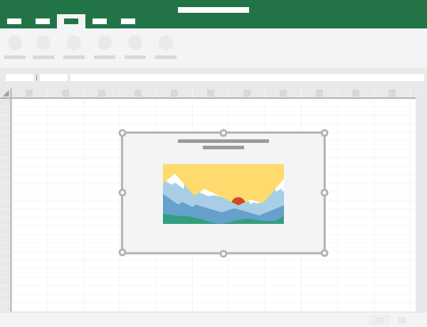
Task panes and content Office Add-ins
Office Add-ins provide several options for how your solution can interact with an Office application.
Task pane Add-ins
Allow interaction through panel displayed within Office application.
Content Add-Ins
Used to insert object into Excel or PowerPoint presentation.
Notes:
Explain Task panes and content Office Add-ins.
For Task Panes, option to demonstrate the Auto-opening a Taskpane with a Document a Document solution that is on GitHub: https://github.com/OfficeDev/Office-Add-in-Commands-Samples/tree/master/AutoOpenTaskpane
For the Content Add-in, option to demonstrate the Excel Content Add in Humongous Insurance solution on GitHub: https://github.com/OfficeDev/Excel-Content-Add-in-Humongous-Insurance

Slide 7
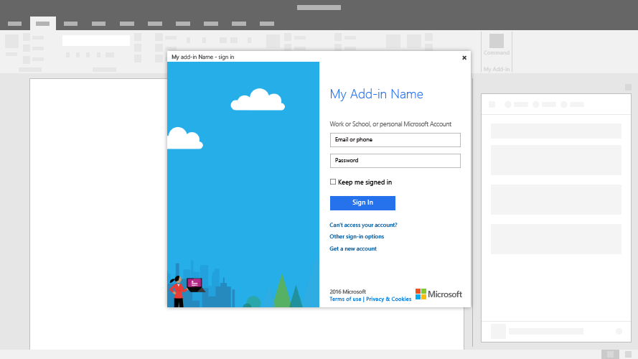
Dialog boxes in Office Add-ins
Dialog boxes are surfaces that float above the active Office application window.
Office Add-ins platform enables to display a dialog for users to:
Sign into an integrated service.
Confirm the user's action.
Run a task that might be confined in a task pane.
Dialog window is not modal
User can continue to interact with Office application and the add-in while dialog window is displayed.
Notes:
Explain Dialog boxes in Office Add-ins.

Slide 8
Custom functions
Custom functions enable developers to add new functions to Excel by defining those functions in JavaScript as part of an Add-in.
Notes:
Explain Custom functions.

Slide 9
Add-in commands
Add-in commands are UI elements that extend the Office UI and start actions in the developer’s Add-in.
Add-in commands in Excel, Word, PowerPoint, and OneNote.
Add-in commands in Outlook.

Slide 10
Demo
Understanding fundamental components and types of Office Add-ins
Notes:
Demo Resources Found Here: https://microsoft.sharepoint.com/:w:/t/MOCtoBaselineevents/EfmVhON3fJVBlKDqhmeenHYBb9YSb2qyV_ZlcgXc8oqtNw?e=AUXbN9

Slide 11
Office JavaScript APIs

Slide 12
Office Add-in programming model
The Office Add-in programming model relies on two JavaScript object models:
Host-specific JavaScript API
Host-specific APIs for Excel and Word providing strongly-typed objects that you can use to access specific elements in host application.
Common API
Enables you to access features such as:
UI.
Dialogs.
Client settings that are common across multiple types of Office applications.

Slide 13
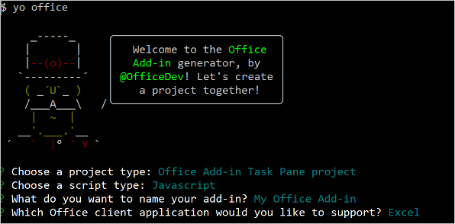
Office Add-in developer tools
Office JavaScript API requirement sets.
Use Office JavaScript APIs.
Make asynchronous calls using proxy objects.

Slide 14
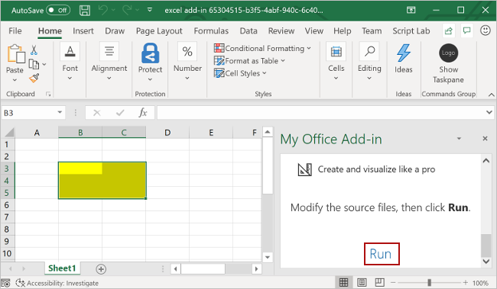
Excel JavaScript API
Object model:
A Workbook contains one or more Worksheets.
A Worksheet gives access to cells through Range objects.
A Range represents a group of contiguous cells.
Ranges are used to create and place Tables, Charts, Shapes, and other data visualization or organization objects.
A Worksheet contains collections of those data objects that are present in the individual sheet.
Workbooks contain collections of some of those data objects (such as Tables) for the entire Workbook.
Ranges.
Charts, tables and other data objects.

Slide 15
Outlook JavaScript API
Outlook JavaScript APIs give Add-ins access to the user’s mailbox, messages, and appointments in Outlook.
Object model:
Mailbox object.
Item object.
Key features.
Module Add-ins.
Item type | Modes
Message | Read Compose
Appointment/meeting | Attendee (read) Organizer (compose)

Slide 16
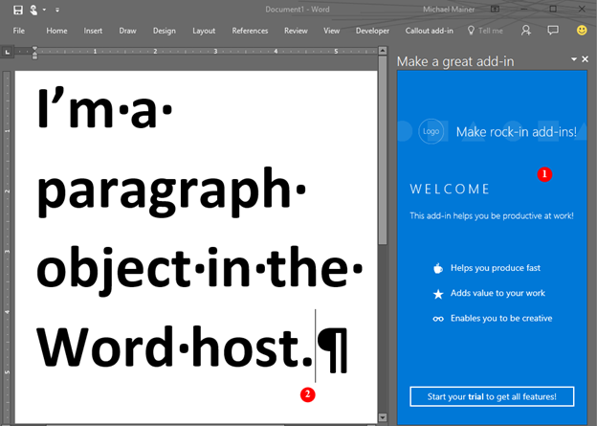
Word JavaScript API
The Word JavaScript APIs give Add-ins access to Word documents.
Object model:
A document contains a body and at least one section.
A body can contain:
Paragraph
Table
List
Text
Objects
Work with document text.
Search.

Slide 17
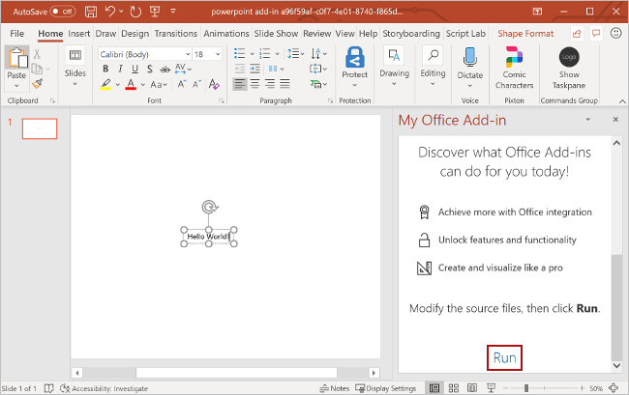
PowerPoint JavaScript API
With PowerPoint add-ins, you can use familiar web technologies such as HTML, CSS, and JavaScript to build a solution that can run in PowerPoint across multiple platforms.
Object model:
PowerPoint JavaScript API.
Common APIs.
PowerPoint Add-Ins.
PowerPoint add-in scenarios.
ActiveViewChanged event.
Navigation.
Get the URL.
Create a presentation.

Slide 18
Custom functions
Custom functions have several unique capabilities and restrictions because they run in a separate runtime from other add-in interactions, like task panes.
Users within Excel can access custom functions just as any native function in Excel, such as SUM().
You can create custom functions that:
Perform simple tasks calculations.
Or more complex tasks such as streaming real-time data from the web into a worksheet.

Slide 19
Demo
Understanding Office JavaScript APIs
Notes:
Demo Resources Found Here: https://microsoft.sharepoint.com/:w:/t/MOCtoBaselineevents/EUbJ_nsSM8tMpL-KeNVgoqEBBFT_Dz2XzreJmrBXu2dqrA?e=XJHgoo

Slide 20
Customization of Add-ins

Slide 21
Overview of customizing Office Add-ins
Office Add-ins extend the Office experience by providing contextual functionality that users can access within Office clients.
Developers consider the following design factors:
Design explicitly for Office.
Focus on a few key tasks; do them well.
Favor content over chrome.
Make it enjoyable and keep users in control.
Design for all platforms and input methods.

Slide 22
Persisting add-in state and settings
Office Add-ins platform provides several ways for your add-in to persist state and settings. Your options depend on the Office applications you plan to support and the type of add-in you plan to develop.
Options to persist state and settings.

Slide 23
Office UI Fabric in Office Add-ins
As you build your add-in, you have UI design factors to consider.
Office UI Fabric has two main areas:
Fabric Core provides basic elements like font, icons, and color.
Fabric React components includes Fabric Core elements and adds input, navigation, and notification components, among others.
Fabric components:
Breadcrumb
Button
Checkbox
ChoiceGroup
Dropdown
Label
List
Pivot
TextField
Toggle

Slide 24
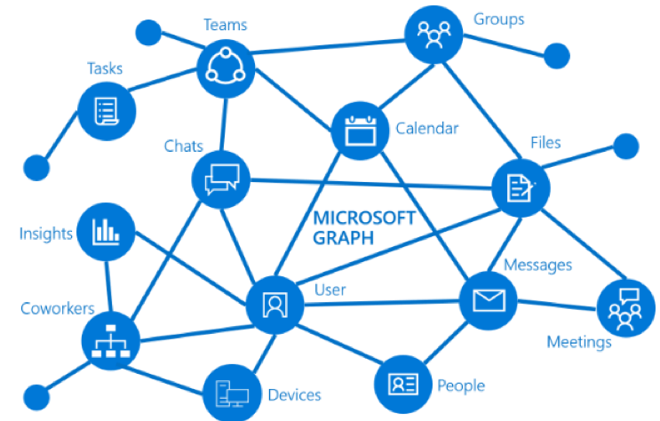
Microsoft Graph in Office Add-ins
Integrating data from online service providers increases the value and adoption of add-ins.
Microsoft Graph REST APIs provide a way for your add-in to access user's data in services like:
Azure Active Directory.
Office 365 services
Enterprise Mobility and Security services
Windows 10 services.
Dynamics 365.

Slide 25
Demo
Understanding customization of Add-ins
Notes:
Demo Resources Found Here: https://microsoft.sharepoint.com/:w:/t/MOCtoBaselineevents/Ea4ys_SzNiNKsHUahNWraM0BOLufAGve-xjVM4rU70ve4A?e=0vD2OO

Slide 26
Testing, debugging, and deployment options for Office Add-ins

Slide 27
Deployment options for Office Add-in
Factors to consider:
Consider... | Examples
Add-in lifecycle stage | local developer testing, ready for public use
Add-in interaction or feature support | task pane add-in, content add-in, add-in commands
Target Office applications | Excel, Outlook
Target platforms | Windows, Mac
Scope of user base | your organization, general public

Slide 28
Deployment options for Office Add-in
Developers have several options for deploying an Add-in.
Deployment options.
Centralized deployment via the Office 365 admin center.
SharePoint app catalog deployment.
Outlook add-in deployment.
Deployment options by Office host.
Word, Excel, and PowerPoint.
Outlook.

Slide 29
Testing and debugging for Office Add-ins
At various points during your add-in's life cycle, developers need to verify functionality and fix bugs.
Option | Description | Best when...
Sideload | Install your add-in locally. | Developer building and testing add-in
Centralized deployment | Distribute your add-in to users via the Microsoft 365 admin center. | Add-in ready for use in your organization on Office 365 or in a hybrid environment
SharePoint catalog | Distribute add-in to users via SharePoint. | Task pane or content add-in ready for use in your organization that's using an on-premises environment; Excel, Word, or PowerPoint is targeted but Mac isn't a target platform
AppSource | Make add-in available to the public. | Add-in ready for public use
Exchange server | Distribute add-in to users via Exchange. | Outlook add-in ready for use in an organization whose environment doesn't use Azure Active Directory identity service
Network share | Make add-in available to network users via a shared folder. | Add-in development and users are on Windows

Slide 30
Testing and debugging for Office Add-ins
Sideload an Office Add-in.
Debug an Office Add-in.
A web browser with the browser's built-in developer tools.
Visual Studio, provided you prepared your add-in using this IDE.
Visual Studio Code for custom functions projects only.
Runtime logging on Windows and Mac.
Validate the manifest file.
Test required Office clients and platforms.

Slide 31
Actionable messages

Slide 32
Overview of actionable messages
Actionable messages enable users to complete the task on messages from services they use every day right from Outlook. Actionable messages can be posted via a group or inbox connector or can be sent directly over email.
Actionable messages via email:
The recipient must be an individual, not a group.
The recipient must be visible on the message. Do not put the recipient in the BCC field.
The recipient must have a mailbox on Outlook.com or Exchange Online in Office 365.

Slide 33
Actionable message with an adaptive card
Adaptive cards communicate information immediately, and their user interface allows users to view and interact with the cards. Adaptive cards allow users to provide a quick response without having to open an app.
Adaptive card layout:
Title.
Descriptive text.
One or more columns of detail.
Refresh adaptive cards:
Approval scenario.
Task status.
Survey.

Slide 34
Demo
Understanding actionable messages
Notes:
Demo Resources Found Here: https://microsoft.sharepoint.com/:w:/t/MOCtoBaselineevents/Edw_fZrXLRdDsm7iWm7dCVQBJ9Y7Cps5DgCQM0PXyAIkqg?e=MYXZdv

Slide 35
Thanks for joining us! Resources for Microsoft 365 developers
You can find Microsoft 365 developer training modules on Microsoft Learn!
Become Microsoft 365 Certified! Earn a Developer Associate certification
Exam MS-600: Building Applications and Solutions with Microsoft 365 Core Services (beta)
Check-out the Microsoft 365 Developer Center! Get the latest Microsoft 365 developer documentation, trainings, blog posts and more. https://developer.Microsoft.com/Microsoft-365

